Slide 1
Introduction to map-reduce
Jiaul Paik
Email: jia.paik@gmail.com

Slide 2
Today’s Topics
Map-reduce: Additional Details
Inverted Index using Map-reduce
Introduction to Spark
Spark Demo

Slide 3
Map-reduce Internals: Additional Details

Slide 4
What Map-Reduce Framework Does for You?
Map-Reduce environment handles the following things
Partitioning the input data
Scheduling the program`s execution across a set of machines
Performing the group by key step
Handling machine failures
Inter-machine communication

Slide 5
Data Flow
Input and final output are stored on a distributed file system
Scheduler tries to schedule map tasks “close” to physical storage location of input data
This minimizes data movement through the network
Intermediate results are stored on local FS of Map and Reduce workers
Output is often input to another Map-reduce task

Slide 6
Coordination by Master
Master node takes care of coordination:
Task status: (idle, in-progress, completed)
Idle tasks get scheduled as workers become available
When a map task completes, it sends the master the location and sizes of its R intermediate files
Master pushes this info to reducers
Master pings workers periodically to detect failures

Slide 7
Dealing with Failures
Map worker failure
Map tasks completed or in-progress at worker are reset to idle
Reduce workers are notified when task is rescheduled on another worker
Reduce worker failure
Only in-progress tasks are reset to idle
Reduce task is restarted
Master failure
Map-reduce task is aborted and client is notified

Slide 8
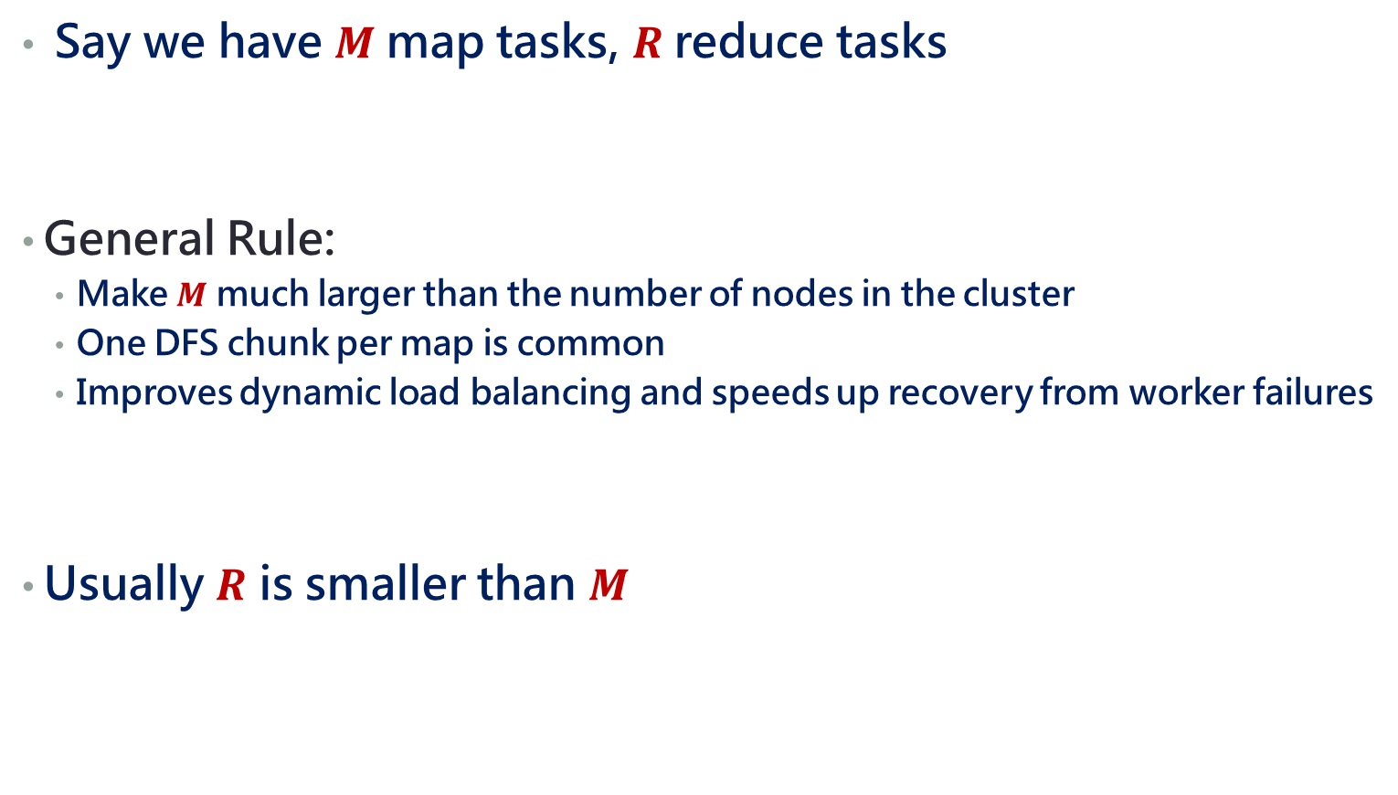
How many Map and Reduce jobs?
Say we have $M$map tasks, $R$reduce tasks
General Rule:
Make $M$ much larger than the number of nodes in the cluster
One DFS chunk per map is common
Improves dynamic load balancing and speeds up recovery from worker failures
Usually $R$ is smaller than $M$

Slide 9
Inverted Index

Slide 10
Inverted Index: Recap
Input: A set of documents
Output: For each term t, store a list of all documents that contain t along with its frequency
vocabulary
posting lists (doc id and frequency)
countrymen
1 2
5 3
11 5
13 6
french
5 3
10 6
17 6
roman
17 3
19 6
Doc ids are unique integers
The posting lists are sorted by doc id for list merging

Slide 11
Inverted Index Construction
Documents
(id, text)
Tokenize the documents into
(word, docid, frequency)
Sort
(word as primary key)
(docid as secondary key)
Create posting lists
in a single pass
1
I am what I am
(am, 1, 2)
(i, 1, 2)
(what, 1, 1)
(am, 1, 2)
(do, 2, 2)
(do, 3, 1)
(i, 1, 2)
(i, 2, 2)
(it, 3, 1)
(now, 3, 1)
(what, 1, 1)
(what, 2, 1)
am: (1, 2)
do: (2, 2) (3, 1)
i: (1, 2) (2,2)
it: (3, 1)
now: (3, 1)
what: (1, 1) (2, 1)
(do, 2, 2)
(i, 2, 2)
(what, 2, 1)
2
I do what I do
(do, 3, 1)
(it, 3, 1)
(now, 3, 1)
3
do it now

Slide 12
Inverted Index Construction: Map-reduce Equivalence
Documents
(id, text)
Tokenize the documents into
(word, docid, frequency)
Sort
(word as primary key)
(docid as secondary key)
Create posting lists
in a single pass
1
I am what I am
(am, 1, 2)
(i, 1, 2)
(what, 1, 1)
(am, 1, 2)
(do, 2, 2)
(do, 3, 1)
(i, 1, 2)
(i, 2, 2)
(it, 3, 1)
(now, 3, 1)
(what, 1, 1)
(what, 2, 1)
am: (1, 2)
do: (2, 2) (3, 1)
i: (1, 2) (2,2)
it: (3, 1)
now: (3, 1)
what: (1, 1) (2, 1)
(do, 2, 2)
(i, 2, 2)
(what, 2, 1)
2
I do what I do
(do, 3, 1)
(it, 3, 1)
(now, 3, 1)
3
do it now
Map function
(you define)
Sort and Shuffle
(system does this)
Reduce function
(your define)

Slide 13

Inverted Index Construction: Map-reduce Algorithm
The anatomy of Map function
Input: document id (key) and its content (value)
Body: tokenization code
Output: list of (word, docid, frequency) triplet
key: word
value: (docid, frequency)
Map pseudo-code
Map(docid n, docText d)
Create a hashtable H (term as key, freq. as value)
for all term t $∈$ d
Insert t into H
for all term t $∈$ H
EMIT (t, (n, freq))

Slide 14
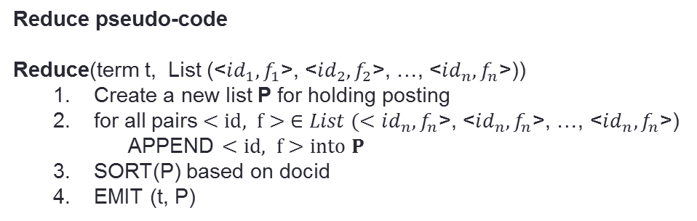
Inverted Index Construction: Map-reduce Algorithm
The anatomy of Reduce function
Input: a term and a list of (docid, frequency) pairs
Body: concatenate list of (docid, frequency) pairs in ascending order of docid
Output: a term and its posting list
Reduce pseudo-code
Reduce(term t, List (<$id_{1}, f_{1}$>, <$id_{2}, f_{2}$>, …, <$id_{n}, f_{n}$>))
Create a new list P for holding posting
for all pairs $<id, f> ∈List (<id_{n}, f_{n}$>, <$id_{n}, f_{n}$>, …, <$id_{n}, f_{n}$>)
APPEND $<id, f>into P$
SORT(P) based on docid
EMIT (t, P)

Slide 15
Distributed Index
Why?
For fast response, index needs to be kept in RAM
For large collection, one machine cannot store entire index
Types of Distributed Index
Document partitioned
Split a document collection into n equal-sized subsets (preferably)
Create one index from one split and keep in different machines
Term partitioned
Terms are split and one index in created for one split
Example
1st index: terms starting with ‘a’; 2nd index: terms starting with ‘b’; and so on
Document partitioned index is widely used approach
Quiz: what kind of index our map-reduce algorithm produces?
Ans: Term partitioned

Slide 16
Spark

Slide 17
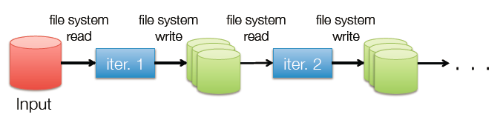
Limitations of basic map-reduce
Standard Map-reduce is great at one-pass computation, but inefficient for multi-pass algorithms
Examples: k-means, PageRank
No efficient mechanism for data sharing
State between steps goes to distributed file system
Slow due to replication & disk storage
Commonly spend 90% of time doing I/O

Slide 18
Spark: Overview
A fast and general purpose cluster computing framework
Up to 20 times faster than Hadoop map-reduce for certain job
Basic map-reduce + many inbuilt functions + rich library
Can run on
Distributed file system (HDFS)
local file systems (unix/linux)

Slide 19
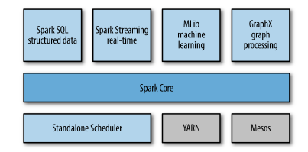
Spark Stack
Spark libraries
Single machine
(Multithreaded applications)
Cluster managers

Slide 20
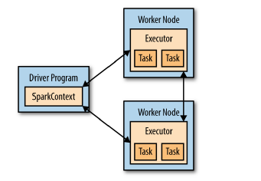
Spark: Components of Distributed Execution

Slide 21
Key Features
In-memory data distribution
Lineage Graph for data loss recovery
Rich Library
Graph, ML, SQL, Streaming data
Multiple Programming language support
Java, Scala, Python
Interactive
Can run one line of code at a time and see the intermediate results

Slide 22
Core Abstraction for Working with Data
Resilient Distributed Dataset (RDD)
Distributed Collection of records or objects
Immutable (can not be changed/modified)
Each RDD is split into multiple partitions, which may be computed on different nodes of the cluster
RDDs can contain any type of Java, Python and Scala objects

Slide 23
Main Steps of a Spark Program
Create some input RDDs from external data (HDFS or Local FS)
Transform them to define new RDDs using transformations like (e.g, filter())
Ask Spark to persist() (keep in memory) any intermediate RDDs that will need to be reused.
Launch actions (e.g, count()) to kick off a parallel computation, which is then optimized and executed by Spark.

Slide 24
Creating an RDD
Two ways to do it
By loading an external dataset from disk
Parallelizing a collection in your driver (main) program
val rdd = sc.textFile(“inputFile”)
val lines = sc.parallelize(List("pandas", "i like pandas"))
sc denotes the spark context that manages the cluster

Slide 25
RDD Operations
Two types of Operations
Transformations
Transformations are operations on RDDs that return a new RDD
Example: map(), filter()
Actions
operations that return a result to the driver program OR write it to storage
It kicks off a computation
Example: count(), saveAsTextFile()
Syntax (scala example)
val newRdd = oldRdd.map(….)
(creates new rdd from oldRdd and saves in newRdd)
User defined code/function

Slide 26
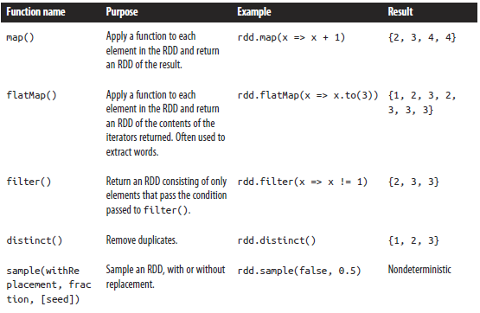
Example of Basic RDD Transformations: Single RDD
RDD containing {1,2,3,3}

Slide 27
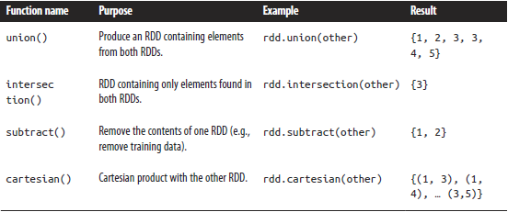
Example of Basic RDD Transformations: Two RDD
Two-RDD transformations on RDDs containing {1, 2, 3} and {3, 4, 5}

Slide 28
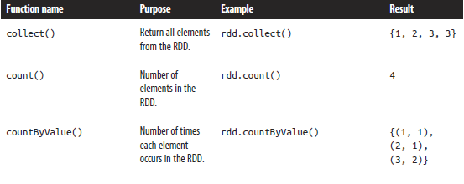

Example of Basic RDD Actions
RDD containing {1, 2, 3, 3}

Slide 29
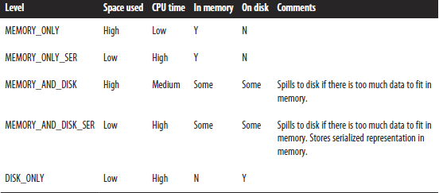
Persistence (Caching)
Goal is to keep rdd in memory, distributed across machines
Very effective for iterative computation
Syntax
yourRdd.MEMORY_ONLY

Slide 30
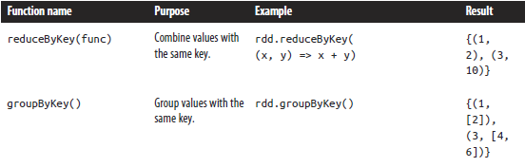
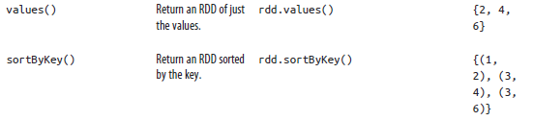
Paired RDD: Example
RDD containing key-value pairs
The fundamental concept behind original map-reduce model
Transformations on one paired RDD containing {(1, 2), (3, 4), (3, 6)}

Slide 31
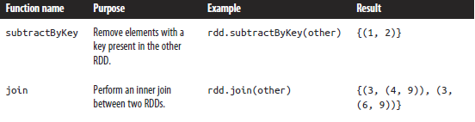
Paired RDD: Example
Transformations on two paired RDDs (rdd = {(1, 2), (3, 4), (3, 6)}, other = {(3, 9)})

Slide 32
ML Library: MLib
Logistic regression
Linear SVM
Generalized linear models (GLMs)
Regression tree
Collaborative filtering: alternating least squares (ALS)
Non-negative matrix factorization (NMF)
k-means
SVD
PCA
Stochastic gradient descent

Slide 33
Graph Library: GraphX
Triangle-counting
Belief Propagation
PageRank
Personalized PageRank
Shortest Path
Graph Coloring
Neural Networks
Graph Semi-supervised learning

Slide 34
Spark Streaming
Run a streaming computation as a series of very small, batch jobs
Chop up the live stream into batches of t seconds
Spark treats each batch of data as RDDs and process them using RDD operations
The processed results are returned as batches

Slide 35
Spark SQL
val teens = context.sql("SELECT name FROM people WHERE age >= 13 AND age <= 19")

Slide 36
Running Spark
On local machine
Interactive
On a cluster
spark-submit –class <main class> --master local[# thread] <jar file> [main class arguments]
spark-shell
spark-submit –class <main class> --master yarn-cluster [options] <jar file> [main class arguments]
where the options can be
--num-executors 10
--driver-memory 4g
--executor-memory 2g
--executor-cores 2

